Slide 1
Proof of Concept
Using ML to Understand How Income Changes Across Zip Codes
Notes:
Using ML to Understand How Income Changes Across Zip Codes

Slide 2
Outline of Presentation
Data Source Overview
Initial data cleaning and feature selection
Different analyzing techniques
Major findings from each technique
Conclusion/Questions

Slide 3

Data Sources
Zillow
ZHVI
US Census
Social and economic factors
IRS
Info about the average filer in zip codes

Slide 4
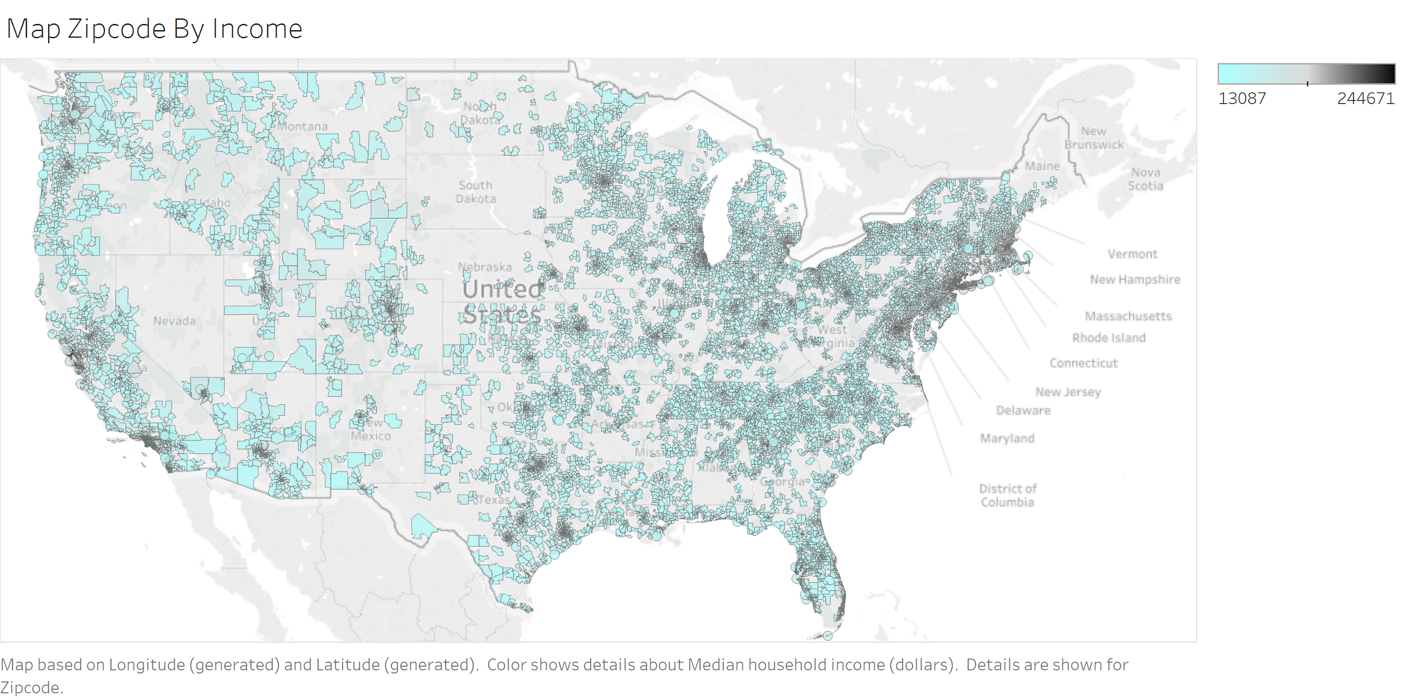
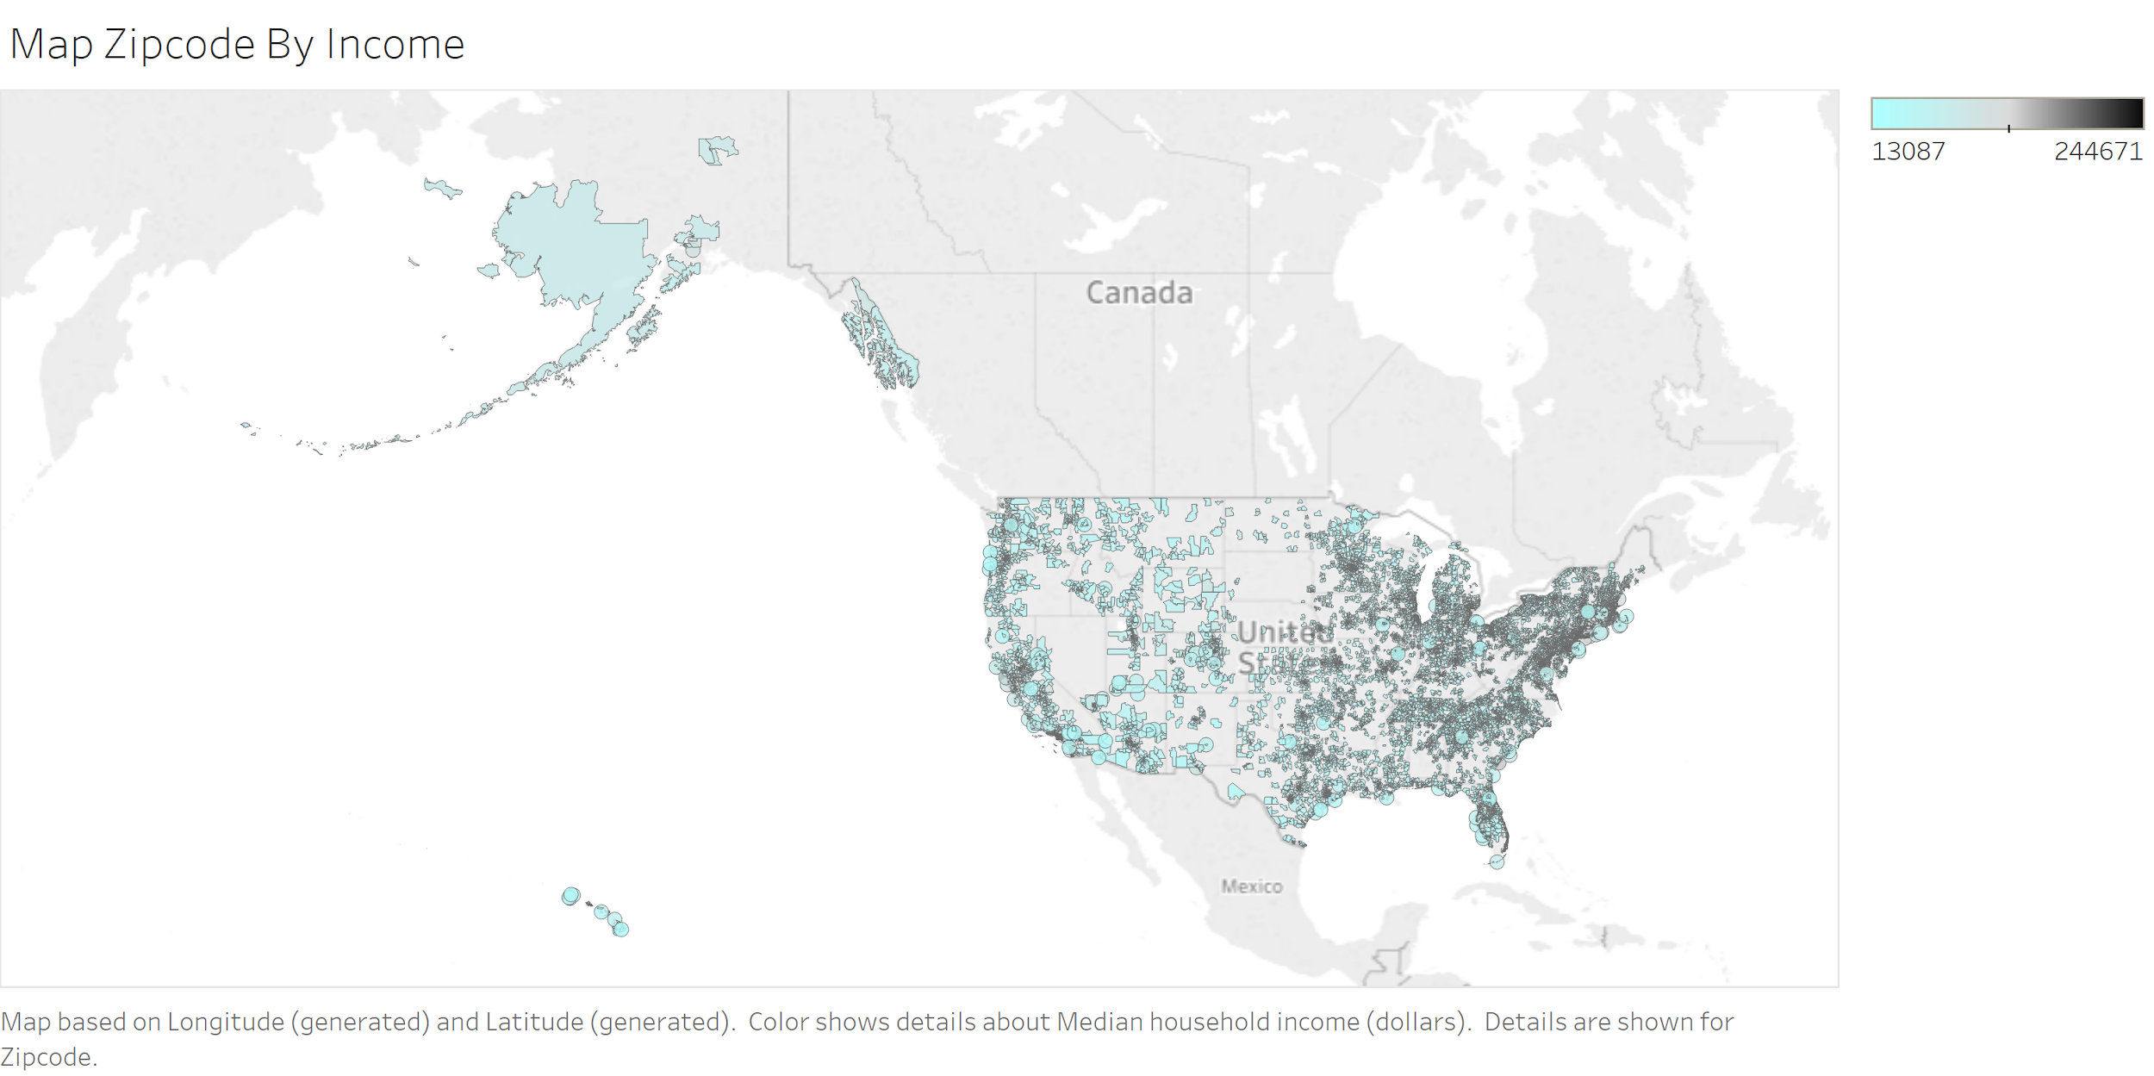
Data Source overview

Slide 5
Data cleaning
IRS
Cleaned each data set individually
Removed duplicate, non-feature, and non-location data
Put each data set in terms of one observation per feature per zip code
IRS data - Averaging and Summing
Census data - keep only estimates
Dropped columns with more than ¼ of the data as NaN
Correlation matrix to reduce features
Imputed remaining NaNs - mean
Zillow
Census - Sex + Age
Merged + Cleaned Data
Census - Business
Census - Social
Census - Economic

Slide 6
Linear Regression

Slide 7
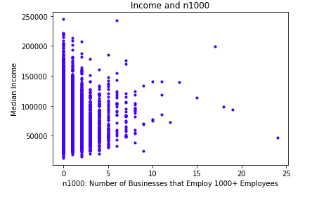
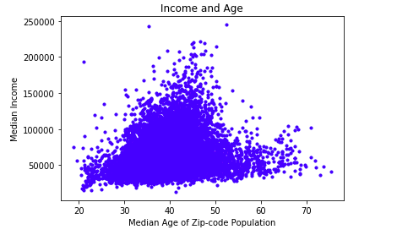
Linear Regression:
Process
Features:
Used the 44 features remaining after data cleaning
Train/Test Split:
80/20
Examples of Coefficients:
N1000: Number of businesses that employ over 1000 people in zip-code
Median age: median age of population in zip-code

Slide 8
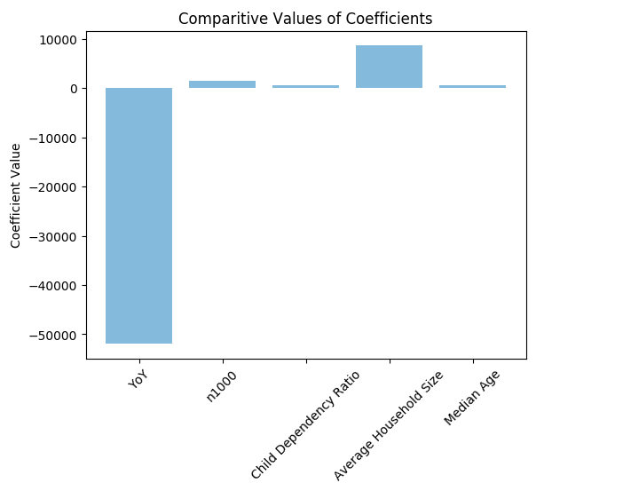
Linear Regression:
Major Findings
Coefficient of Correlation:
R²: 0.725
MSE
Was able to predict median household income within +/- $11,380.91

Slide 9

Feature Selection
Used the below methods:
RFE
PCA
Anova
Decision Tree Analysis
Came up with a list of 20 features by taking into account the results from RFE, ANOVA analysis, and Decision Tree Analysis.

Slide 10
Classification

Slide 11
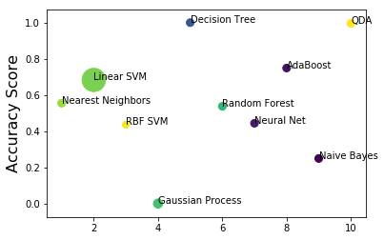
Classification: What is the best classifier in Scikit Learn?
Response variable - Income Level
Size of dot represents the amount of time needed to run the classifier
AdaBoost is the best
Notes:
Linear SVM 83 minutes
Small dots took 0 - 3 seconds to run
Gaussian process took 40 min to run
Ada boost 2 seconds

Slide 12
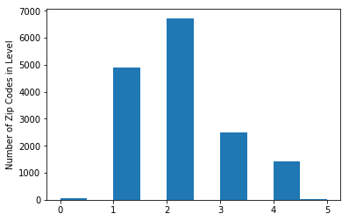
Classification : Income Level
Accuracy Score = .74

Slide 13
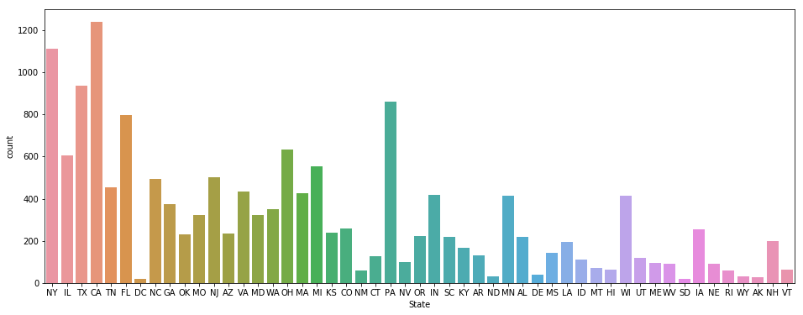
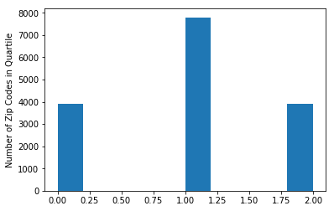
Classification : Income Quartile vs State
Income Quartile
Accuracy Score = 1
Less categories to fit to
Housing data correlates to income
State
Accuracy Score = .1
Too many categories
Variance within each state
Notes:
Should I do this analysis only using the only using the 20some features???

Slide 14
Clustering

Slide 15
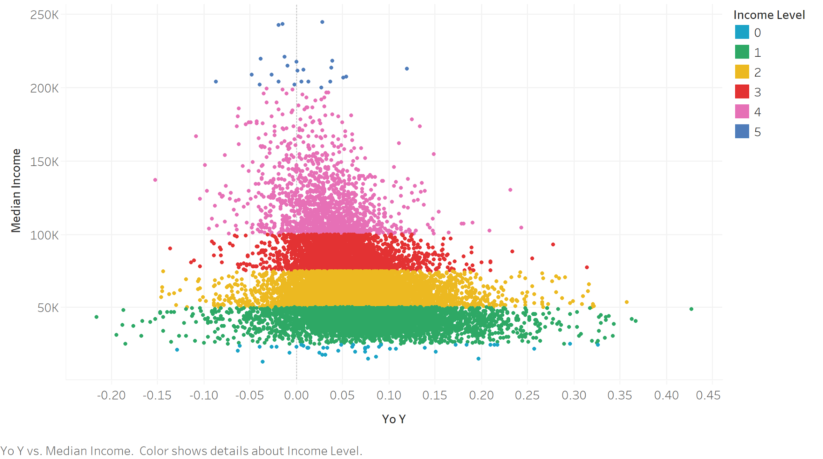
ML-Specific Tools
Supervised Learning
Linear Regression
Classification
Unsupervised Learning
Clustering
Unseen relationships

Slide 16
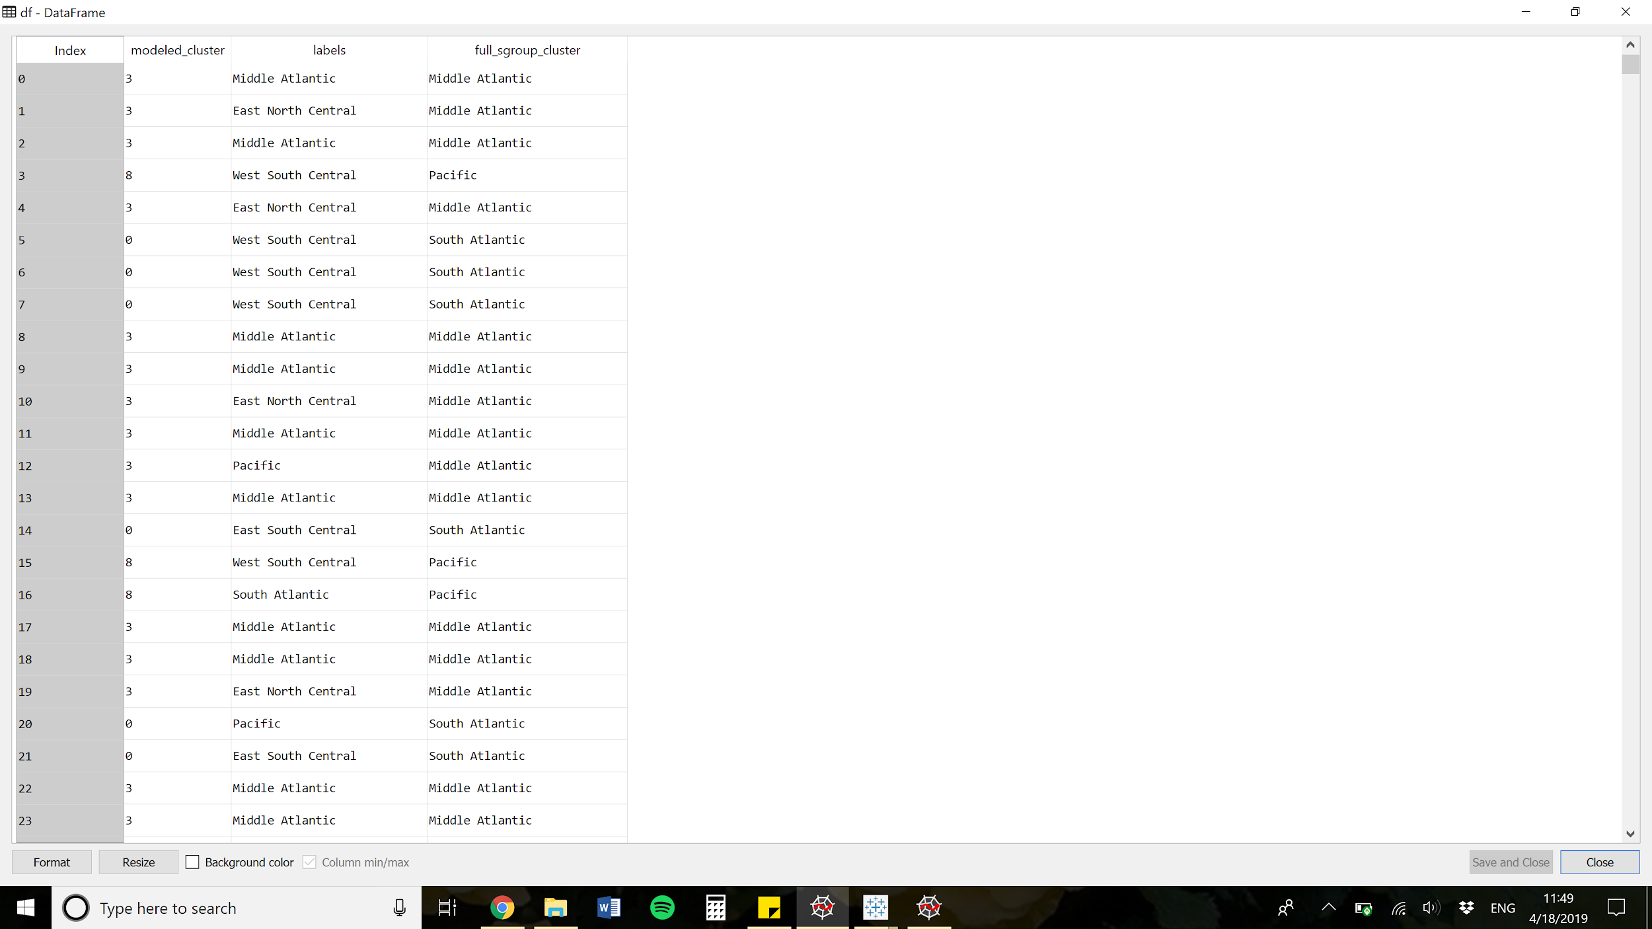
Clustering: What do these clusters mean?
New England | 0
Mid-Atlantic | 1
East North Central | 2
West North Central | 3
South Atlantic | 4
East South Central | 5
West South Central | 6
Mountain | 7
Pacific | 8
Cluster Numbers
Original Region Names
Cluster Name
?
Notes:
Each line is a unique randomly zipcode, assigned most common label to value (e.g. Middle Atlantic to 3)

Slide 17


Slide 18
Clustering: Summary of Major Findings
YOY has opposite behavior to intuition
“Florida” has a lot of old people
"Pennsylvania" has relatively stable housing prices...
Middle Atlantic vs. Pacific
IRS Income Clustering worked alright
Higher income, more big business

Slide 19
The Bottom Line and Next Steps
We did not discover enough significant results to justify moving forward with the full project.
Try a different response variable
Different features or more balanced data
Expand to a NN

Slide 20
Thank You!
Questions?

